Slide 1
Biochemistry – 12U
Sarah Abdelmassih

Slide 2
Workshop Outline
The importance of carbon
Anabolic and Catabolic reactions
Biological macromolecules
Carbohydrates
Lipids
Proteins
Nucleic acids
STSE

Slide 3
1. The Importance of Carbon
Highly important element when teaching biochemistry
Has 4 valence electrons, therefore can make up to 4 bonds
Bonding capacity
Using a periodic table to understand valance electrons
Various elements including H, O, S, and P can bond
to carbon to form functional groups
There are many functional groups found in biological molecules

Slide 4
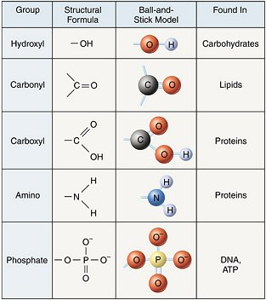
1. The Importance of Carbon
Biochemistry Functional groups
Worksheet identifying various functional groups (scariest sheet they will ever see)
Notes:
Hand out worksheet

Slide 5
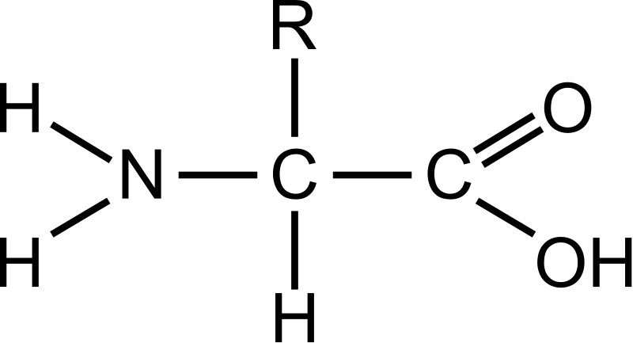
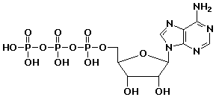
3. Biological Macromolecules
Carbohydrates
Monosaccharide's
Lipids
Fatty acids and Glycerol
Proteins
Amino acids
Nucleic Acids
Nucleotides
Notes:
All 4 biological macromolecules are made up of individual subunits
I like to call them building blocks
Inset picture of 4 macromolecules and individual subunits
They go through various reactions to form the larger macromolecule

Slide 6
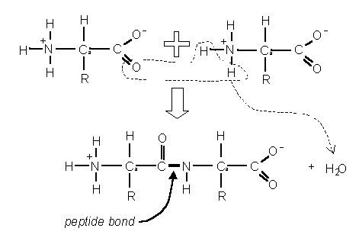
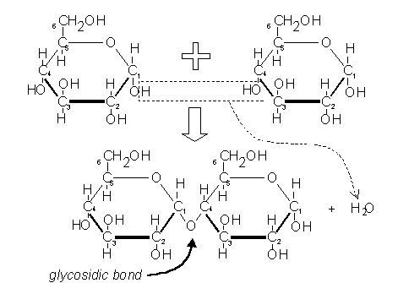
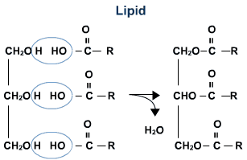
2. Anabolic and Catabolic Reactions
Anabolic reactions: produce large molecules from smaller subunits
They include condensation reactions, where water is removed
Activity building macromolecules
Notes:
Happens between functional groups
Activity building larger macromolecules

Slide 7
2. Anabolic and Catabolic Reactions
Catabolic reactions: break macromolecules down into their individual subunits
They include hydrolysis reactions, where water is needed
Simulation

Slide 8
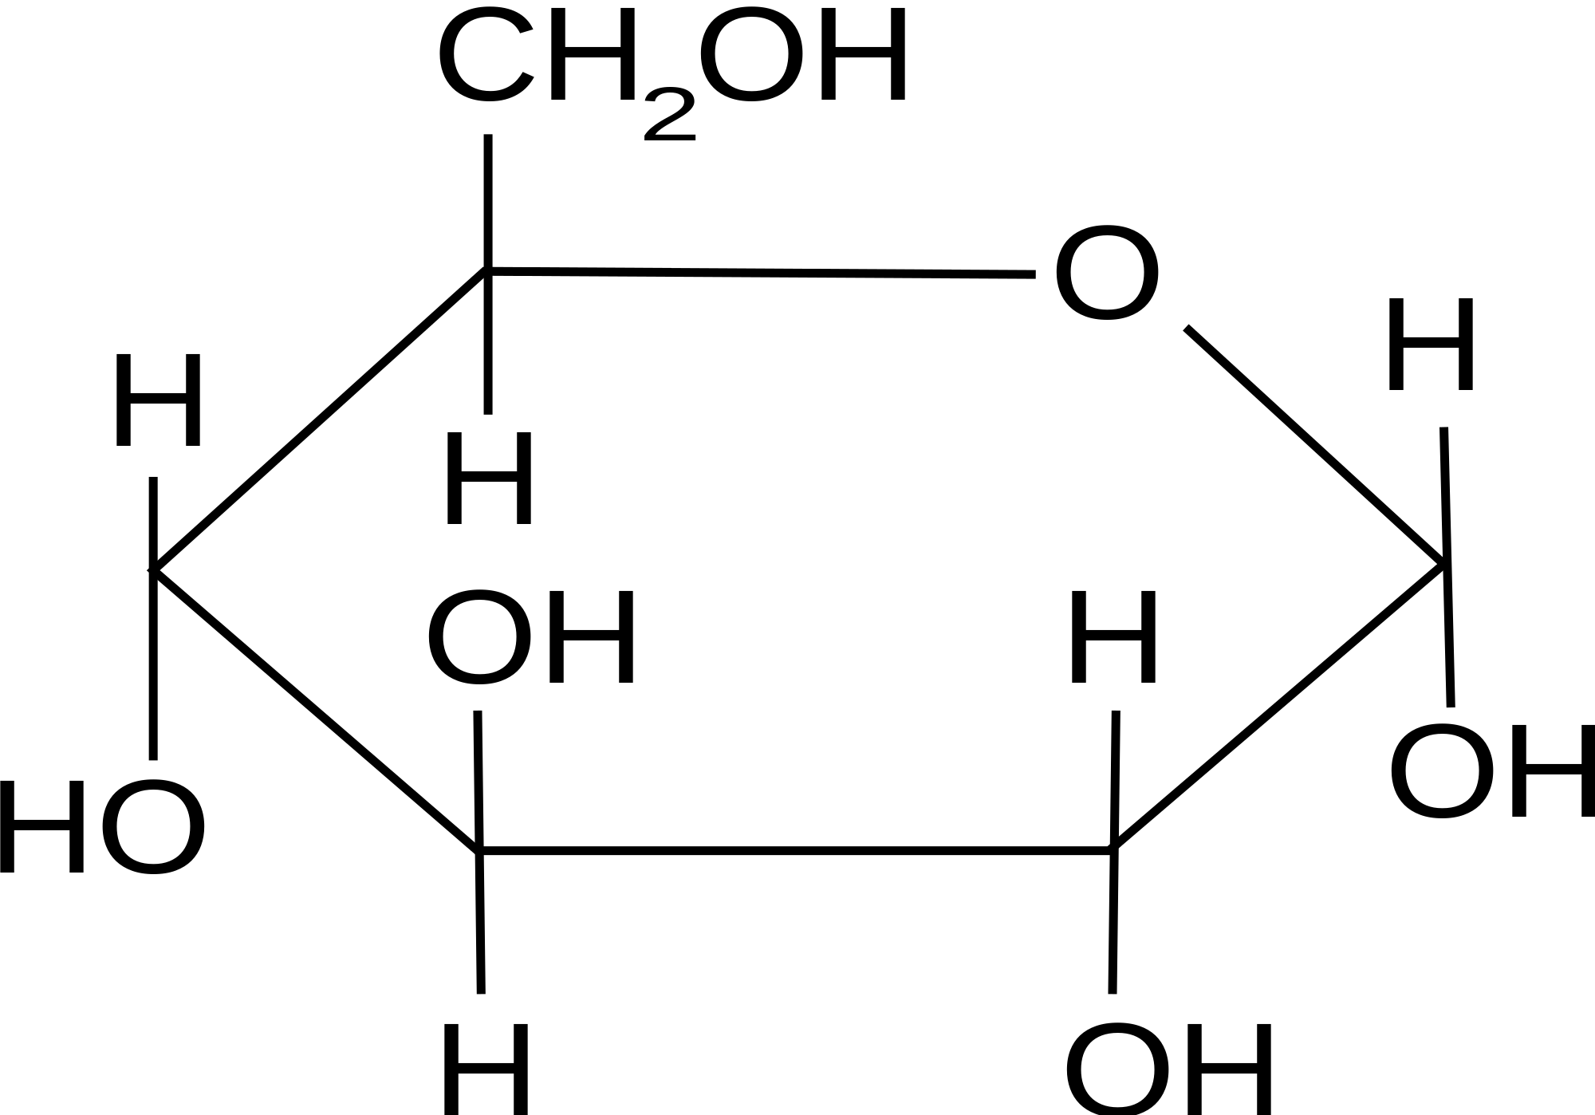
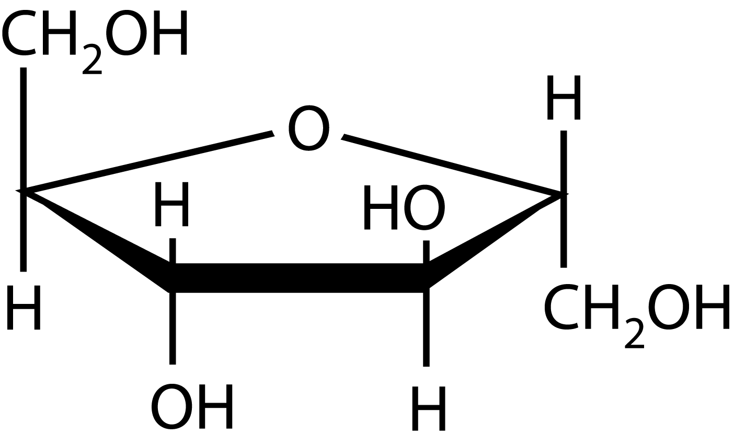
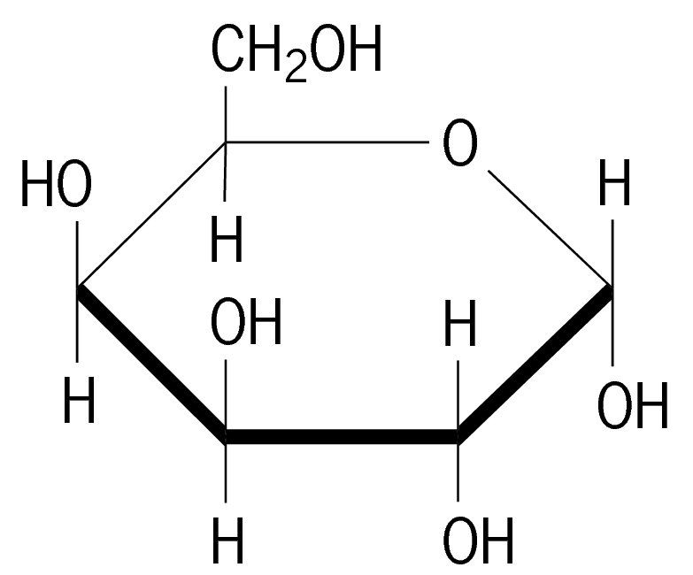
3. Biological Macromolecules: Carbohydrates
Contain C, H and O atoms
Carbohydrate
Monosaccharide
Disaccharide
Polysaccharide
α-Glucose
Fructose
Galactose
Maltose
Sucrose
Lactose
Starch (amlyopectin)
Glycogen
Cellulose
Glucose + Glucose
Polymer of α-glucose
Polymer of α-glucose
Glucose + Fructose
Glucose + Galactose
Polymer of β-glucose
Notes:
Simple sugar molecules (all isomers of each other): Glucose (source of energy in all cells), fructose (fruit sugar), galactose (component of lactose milk sugar),
2 sugar molecules linked
Starch (amylopectin) and glycogen are energy storage polysaccharides (a-1–4 glycosidic linkages between –glucose monomers in the main chain and a-1–6 linkages at the branch points)
Cellulose is a structural polysaccharide ( B-1–4 glycosidic linkages)

Slide 9
3. Biological Macromolecules: Carbohydrates
Notes:
Importance of showing the structure
Activity making disaccharides with beads
Starch (amylopectin) and glycogen are energy storage polysaccharides (a-1–4 glycosidic linkages between –glucose monomers in the main chain and a-1–6 linkages at the branch points)
Cellulose is a structural polysaccharide ( B-1–4 glycosidic linkages)

Slide 10
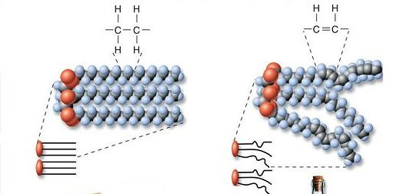
3. Biological Macromolecules: Lipids
Hydrophobic molecules (non-polar) composed of C, H, and O
Most common energy storing molecules
Most common fats in plants and animals are triglycerides (3 fatty acids + glycerol)
Saturated fatty acids: All single bonds between C atoms, max amount of H’s
Unsaturated fatty acids: 1 or more double bonds between C atoms, fewer than max amount of H’s
Notes:
Show examples
Ester linkage between the carboxy and hydroxyl groups – condensation reaction
Glycerol is a three-carbon alcohol containing a hydroxyl group attached to each carbon. Fatty acids are long hydrocarbon chains containing a single carboxyl group (COOH) at one end

Slide 11
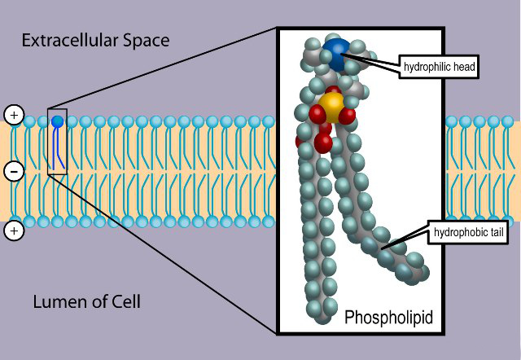
3. Biological Macromolecules: Lipids
Phospholipids: Molecule that consists of 2 fatty acid tails + glycerol + phosphate group
Make up the cell membrane
Membranes contain another class of lipids known as sterols (steroids)
Hydrophobic molecules
Contains 4 fused hydrocarbon rings and many functional groups
Include sex hormones: testosterone, estrogens, and progesterone
Notes:
Cell membrane activity with bubbles

Slide 12
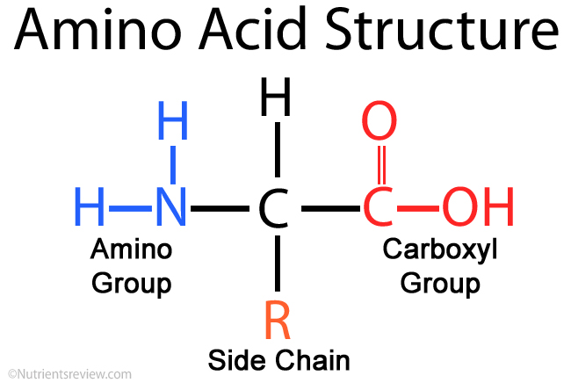
3. Biological Macromolecules: Proteins
Most diverse molecules in living organisms
Cells contain thousands of different proteins with various functions
Enzymes: Biological catalysts, speeding up chemical reactions
Immunoglobulins: Protect animals from foreign microbes
Hemoglobin: Carry oxygen throughout mammals
Keratin: Tough structural protein found in hair and fingernails
Polymers of amino acids
Held together by peptide bonds
20 different R groups in living organisms
8 amino acids are considered essential

Slide 13
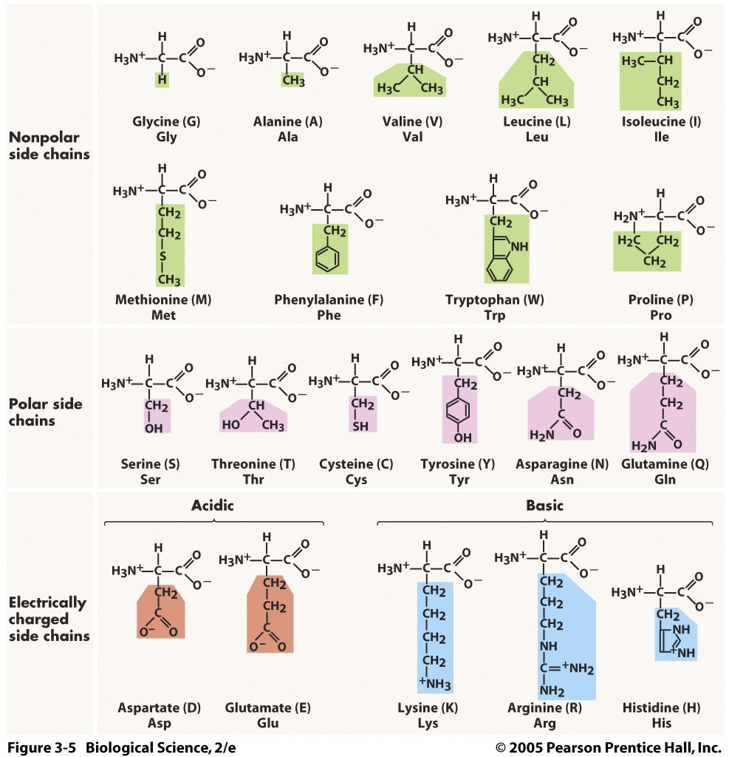
3. Biological Macromolecules: Proteins

Slide 14
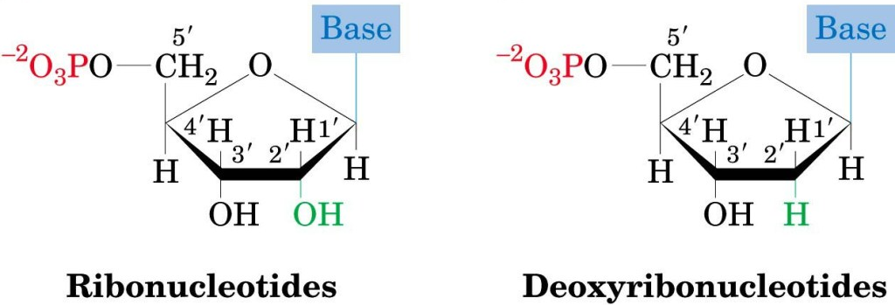
3. Biological Macromolecules: Nucleic Acids
Store hereditary information of organisms
DNA: (Double stranded) The digital code that stores the instructions for creating an organism
RNA: (Single stranded) Reads the information in DNA and transports it to the protein-building apparatus of the cell
Both are polymers of nucleotides
Nitrogenous base, pentose sugar, phosphate group
Phosphodiester bonds
Gummy Bear double helix activity
Notes:
A pairs with T
G pairs with C
ftp://ftp.sanger.ac.uk/pub/yourgenome/downloads/activities/yummy-gummy-dna/ftyummygummyinsta4.pdf

Slide 15
STSE
Real world applications of protein enzymes
Natural enzymes are used in many food production processes to speed up chemical reactions,
Examples:
Rennet, a natural enzyme mixture from the stomach of calves, used in cheese making. Contains a protease enzyme that coagulates milk, causing it to separate into solids (curds) and liquids (whey
Enzymes produced by yeast have been used to ferment grape juice in order to make wine.
Scientists are designing and producing synthetic enzymes that will be more efficient catalysts and allow new technological applications in medicine and industry.
Enzymes produced through biotechnology are identical to those found in nature.
Genetically modified microorganisms would not survive in nature.

